Slide 1
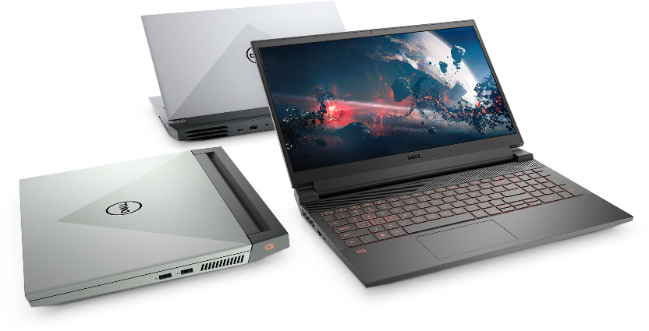
Dell G Series | Gaming Laptops

Slide 2
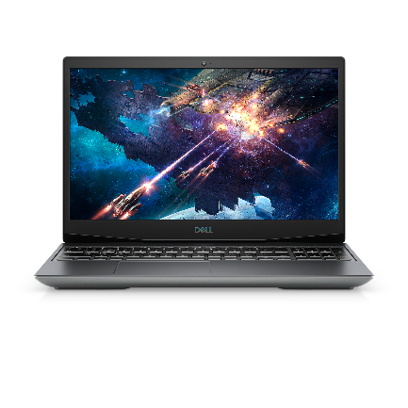
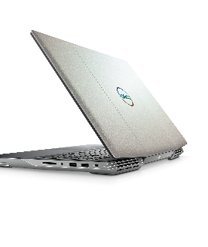
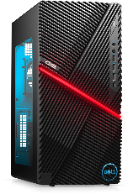
Dell G Series | Awards & Reviews
Dell G5 15 SE
“The Best Cheap Gaming Laptops for 2021: Best for an Extra Emphasis on CPU Power" — PCMag
Dell G5 15
"Best Gaming Laptops for 2021" inclusion, "Best gaming value under $1,000" — CNET
Dell G5 Gaming Desktop
"Best computer 2021: roundup winner " — Tech Radar
Notes:
Tech Radar: Best computers 2021: the best PCs you can buy | TechRadar

Slide 3
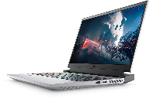
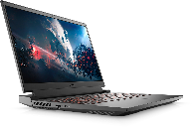
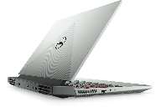
Dell G Series | Laptops
 | G15 10th Gen | G15 11th Gen (June 2021) | G15 Ryzen Edition | G15 Special Edition
Positioning | Fierce gaming laptop – inside and out. Designed for intense gaming and multi-tasking for entry-level or mainstream gamers |  |  | Powerful gaming in a sophisticated design that easily goes from meeting/classroom to gaming at home or on the go
Screen size | 15.6” | 15.6” | 15.6” | 15.6”
Processor | 10th Gen Intel® Core™ i5 or i7 (up to 6-cores and 12 threads) | 11th Gen Intel® Core™ i5 or i7 (up to 6-cores and 12 threads) | AMD® Ryzen™ 5 5600H Mobile Processor AMD® Ryzen™ 7 5800H Mobile Processor | 11th Gen Intel® Core™ i5, up to 6-cores and 12 threads)
Graphics | Up to NVIDIA® GeForce® RTX 3060 with 6GB GDDR6 graphics | Up to NVIDIA® GeForce® RTX 3060 with 6GB GDDR6 graphics | Up to NVIDIA® GeForce® RTX 3060 with 6GB GDDR6 graphics | Up to NVIDIA® GeForce® RTX 3060 with 6GB GDDR6 graphics
Storage | Up 2TB M.2 PCle SSD | Up 2TB M.2 PCle SSD | Up 2TB M.2 PCle SSD | Up 2TB M.2 PCle SSD
Battery life | TBC | TBC | TBC | TBC
Starting weight | 5.39 lb (2.4449kg) | 5.39 lb (2.4449kg) | TBC | TBC
Notes:
G3:
15”: up to 8 hours 32 minutes of Mobile Mark 14 battery life (i7, 1060MQ, FHD, 6GB GDDR5 video memory, 8GB DDR4 2666MHz (4Gx2), 128G SSD +1TB 5.4 HDD)
The Dell G3 15 starting weight* is 5.4 lb (2.45 kg) when equipped with 8th Generation Intel® Core™ i5-8300HQ Processor, NVIDIA® GeForce® GTX 1050Ti, 4GB GDDR5 video memory, 8GB DDR4 2666MHz (8Gx2), 128G SSD +1TB 5.4 HDD, FHD non-touch display, non-backlit keyboard, 4 cell 56WHr battery, as tested by Dell labs March 31, 2018.***
17”: up to 7 hours 57 minutes of Mobile Mark 14 battery life (i7, 1050Ti, FHD, 4GB GDDR5 video memory, 16GB DDR4 2666MHz (8Gx2), 128G SSD +1TB 5.4 HDD)
The Dell G3 17 starting weight* is 6.46 lb (2.93 kg) when equipped with 8th Generation Intel® Core™ i5-8300HQ Processor, NVIDIA® GeForce® GTX 1050Ti, 4GB GDDR5 video memory, 16GB DDR4 2666MHz (8Gx1), 128G SSD +1TB 5.4 HDD, FHD non-touch display, non-backlit keyboard, 4 cell 56WHr battery, as tested by Dell labs March 31, 2018, , options & configurations are subject to regional availability.***
G5:
The new Dell G5 15 has up to 10 hours 38 minutes of Mobile Mark 14 battery life with DPST, Vari-Bright or DBC enabled (if supported), when equipped with 8th Generation Intel® Core™ i5-8300HQ Processor, Intel UHD Graphics 630 and NVIDIA GTX1050Ti graphics with 8GB GDDR5 dedicated memory, 8GB x 1 DDR4 system memory,128G SSD +1TB 5.4 HDD, FHD non-touch display, Windows 10 and 60WHr* battery, as tested by Dell labs 12/22/2018..**
The Dell G5 15 starting weight* is 5.9 lb (2.68kg) when equipped with 8th Generation Intel® Core™ i5 Processor, Intel UHD Graphics 630 and NVIDIA GTX1050Ti graphics with 4GB GDDR5 dedicated memory, 8GB x 1 DDR4 system memory, 128G SSD +1TB 5.4 HDD, FHD non-touch display, non-backlit keyboard and a 60WHr battery, as tested by ODM labs 12/22/2018, options & configurations are subject to regional availability.***
G7:
15”: The Dell G7 15 has up to X hours XX minutes of Mobile Mark 14 battery life with DPST enabled, when equipped with 8th Generation Intel® Core™ i5-8300HQ Processor, Intel UHD Graphics 630 and NVIDIA GTX 1050Ti graphics, 4GB GDDR5, 8GB DDR4 2666MHz (8Gx1), 128GB SSD and 1TB 5400 RPM, FHD non-touch display, Windows 10 and 60WHr* battery, as tested by Dell labs February 26, 2018.**
The Dell G7 15 starting weight* is 5.5 lb (2.49 kg) when equipped with 8th Generation Intel® Core™ i5-8300HQ Processor, Intel UHD Graphics 630 and NVIDIA GTX 1050Ti graphics, 4GB GDDR5, 8GB DDR4 2666MHz (8Gx1), 128GB SSD + 1TB 5400 RPM, FHD non-touch display, non-backlit keyboard and a 60WHr battery, as tested by ODM labs 12/22/2018 , options & configurations are subject to regional availability.***
17”:
15”: The Dell G7 17 has up to X hours XX minutes of Mobile Mark 14 battery life with DPST enabled, when equipped with 8th Generation Intel® Core™ i5-8300HQ Processor, Intel UHD Graphics 630 and NVIDIA RTX 2060 graphics, 8GB GDDR5, 8GB DDR4 2666MHz (8Gx1), 128GB SSD and 1TB 5400 RPM, FHD non-touch display, Windows 10 and 60WHr* battery, as tested by Dell labs February 26, 2018.**
The Dell G7 17 starting weight* is 6.93 lb (3.14 kg) when equipped with 8th Generation Intel® Core™ i5-8300HQ Processor, Intel UHD Graphics 630 and NVIDIA RTX 2060 graphics, 8GB GDDR5, 8GB DDR4 2666MHz (8Gx1), 128GB SSD + 1TB 5400 RPM, FHD non-touch display, non-backlit keyboard and a 60WHr battery, as tested by ODM labs 12/22/2018 , options & configurations are subject to regional availability.***
*The stated Watt Hour (WHr) is not an indication of battery life.
** Battery life is based on Mobile Mark 2014 benchmark test, available at www.bapco.com. Test results are for comparative purposes only. Actual battery life may be significantly less than the test results and varies depending on product configuration and use, software, usage, operating conditions, power management settings and other factors. Maximum battery life will decrease with time.

Slide 4
Dell G15 10th Gen
5510
Designed to power your next adventure with 10th Gen Intel Core Processors, the latest NVIDIA GeForce graphics, improved thermals at an accessible price. COLOR OPTIONS: Dark Shadow Grey, Specter Green with Speckles, Phantom Grey with speckles | Recommended Accessories Dell Gaming Backpack 17 | GM1720PM Dell Gaming 27 Monitor | S2719DGF Alienware Stereo Gaming Headset | AW310H Alienware Wireless Gaming Mouse | AW310M Alienware RGB Mechanical Gaming Keyboard | AW410K
Key features | Why it matters
10th Gen Intel® 4 & 6-core H-Series CPUs – i5 to i7 | Provides responsive, powerful performance whether you’re gaming, streaming videos, or working on CPU-intensive projects
NVIDIA® GeForce® discrete graphics up to RTX 3060 | Allows gaming at higher settings with crystal-clear detail and smooth, realistic gameplay for a more immersive on-screen experience
Improved thermals | Improved thermal design with copper pipes and up to 4 exhaust vents (2 vents on GTX 1650)
15.6” FHD (1920 x 1080) 120Hz (250nits) display panel with 2-sided narrow bezels or optional 165Hz (300nits) | Gameplay appears sharp from virtually every angle on the screen with a wide-viewing angle for deeper immersion
Game Shift enables dynamic performance mode during periods of intense gaming | Keeps laptop cool and performing optimally during periods of intense gaming or heavy CPU usage
Easy-to-care-for plastic and low-VOC paint | Fuss-free and ready to game on the go
SSD options up to 2TB PCIe M.2 (Class 40) | SSD options improve responsiveness & battery life, fast application loading and performance
Alienware Command Center | Controls customization of the optional backlit 4-zone RGB keyboard and advanced sound features with nahimic 3D Audio for Gamers.

Slide 5
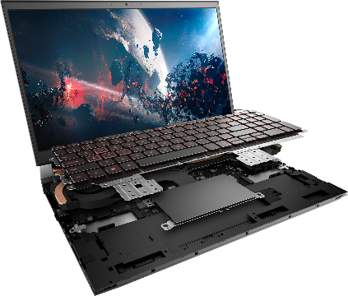
Key Claims: Dell G15
Configuration | MobileMark 2014
10th Gen Intel® Core™ i5, NVIDIA GTX 1650, 4GB GDDR6, 8GB DDR4 3200MHz, 256G M.2 SSD, FHD 120Hz, 3-cell 56Hr battery* | Up to 11 hours 47 minutes**
*The stated Watt Hour (WHr) is not an indication of battery life.
** Battery life is based on Mobile Mark 2014 benchmark test, available at www.bapco.com. Test results are for comparative purposes only. Actual battery life may be significantly less than the test results and varies depending on product configuration and use, software, usage, operating conditions, power management settings and other factors. Maximum battery life will decrease with time.

Slide 6
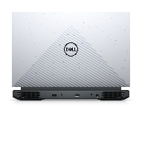
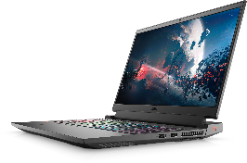
Dell G15 11th Gen
5511
Designed to power your next adventure with 11th Gen Intel Core Processors, the latest NVIDIA GeForce graphics, improved thermals, and 100/100 concurrency at an accessible price. COLOR OPTIONS: Dark Shadow Grey, Specter Green with Speckles, Phantom Grey with speckles | Recommended Accessories Dell Gaming Backpack 17 | GM1720PM Dell Gaming 27 Monitor | S2719DGF Alienware Stereo Gaming Headset | AW310H Alienware Wireless Gaming Mouse | AW310M Alienware RGB Mechanical Gaming Keyboard | AW410K
Key features | Why it matters
11th Gen Intel® 4 & 6-core H-Series CPUs – i5 to i7 | Provides responsive, powerful performance whether you’re gaming, streaming videos, or working on CPU-intensive projects
Discrete graphics up to NVIDIA® GeForce RTX™ 3060 | Allows gaming at higher settings with crystal-clear detail and smooth, realistic gameplay for a more immersive on-screen experience
Improved thermals | Improved thermal design with copper pipes and up to 4 exhaust vents (2 vents on GTX 1650)
15.6” FHD (1920 x 1080) 120Hz (250nits) display panel with 2-sided narrow bezels or optional 165Hz (300nits) | Gameplay appears sharp from virtually every angle on the screen with a wide-viewing angle for deeper immersion
Game Shift enables dynamic performance mode during periods of intense gaming | Keeps laptop cool and performing optimally during periods of intense gaming or heavy CPU usage
Easy-to-care-for plastic and low-VOC paint | Fuss-free and ready to game on the go
SSD options up to 2TB PCIe M.2 (Class 40) | SSD options improve responsiveness & battery life, fast application loading and performance
Alienware Command Center | Controls customization of the optional backlit 4-zone RGB keyboard and advanced sound features with nahimic 3D Audio for Gamers.

Slide 7
Key Claims: Dell G15 11th Gen
Configuration | MobileMark 2014
Tbd | tbd
*The stated Watt Hour (WHr) is not an indication of battery life.
** Battery life is based on Mobile Mark 2014 benchmark test, available at www.bapco.com. Test results are for comparative purposes only. Actual battery life may be significantly less than the test results and varies depending on product configuration and use, software, usage, operating conditions, power management settings and other factors. Maximum battery life will decrease with time.

Slide 8
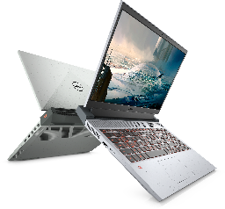
Dell G15 Ryzen Edition
5515
Designed for every adventure with AMD Ryzen™ 5000 H-Series Mobile Processors, NVIDIA® GeForce RTX™ graphics, and improved thermal technology. COLOR OPTIONS: Specter Green with Speckles, Phantom Grey with speckles | Recommended Accessories Dell Gaming Backpack 17 | GM1720PM Dell 32 Curved Gaming Monitor | S3220DGF Alienware 7.1 Gaming Headset | AW510H Alienware Wired Gaming Mouse | AW510M Alienware Low-Profile Mechanical Gaming Keyboard | AW510K
Key features | Why it matters
AMD Ryzen™ 5000 Series Mobile Processors up to R7 5800H, 8-core/16-Thread (16M Cache, up to 4.4 GHz) | Provides responsive, powerful performance whether you’re gaming, streaming videos, or working on CPU-intensive projects
Up to NVIDIA® GeForce RTX™ 3060 graphics cards | Allows gaming at higher settings with crystal-clear detail and smooth, realistic gameplay for a more immersive on-screen experience
Improved thermals | Improved thermal design with copper pipes and 4 exhaust vents
15.6” FHD (1920 x 1080) 120Hz (250nits) display panel with 2-sided narrow bezels or optional 165Hz (300nits) | Gameplay appears sharp from virtually every angle on the screen with a wide-viewing angle for deeper immersion
Game Shift enables dynamic performance mode during periods of intense gaming | Keeps laptop cool and performing optimally during periods of intense gaming or heavy CPU usage
Easy-to-care-for plastic and low-VOC paint | Fuss-free and ready to game on the go
SSD options up to 1TB PCIe M.2 (Class 40) | SSD options improve responsiveness & battery life, fast application loading and performance
Alienware Command Center | Controls customization of the optional backlit 4-zone RGB keyboard and advanced sound features with nahimic 3D Audio for Gamers.

Slide 9
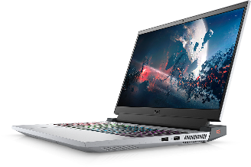
Key Claims: Dell G5 15 Ryzen Edition (5515)
Configuration | MobileMark 2014
AMD Ryzen™ 7 5800H, NVIDIA RTX 3060, 6GB GDDR6, 8GB DDR4 3200MHz, 512GB M.2 SSD, FHD 120Hz, 86WHr 6-cell battery* | Up to 13 hours 02 minutes**
*The stated Watt Hour (WHr) is not an indication of battery life.
** Battery life is based on Mobile Mark 2014 benchmark test, available at www.bapco.com. Test results are for comparative purposes only. Actual battery life may be significantly less than the test results and varies depending on product configuration and use, software, usage, operating conditions, power management settings and other factors. Maximum battery life will decrease with time.

Slide 10
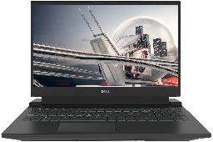
Dell G15 SE
5511
Game in style with up to 11th Gen Intel® Core™ i7 processors and NVIDIA® GeForce RTX™ graphics in a sophisticated design for work, school, or gaming almost anywhere. COLOR OPTIONS: Obsidian Black | Recommended Accessories Dell Gaming Backpack 17 | GM1720PM Dell 32 Curved Gaming Monitor | S3220DGF Alienware 7.1 Gaming Headset | AW510H Alienware Wired Gaming Mouse | AW510M Alienware Low-Profile Mechanical Gaming Keyboard | AW510K
Key features | Why it matters
11th Gen Intel® 4 & 6-core H-Series CPUs – i5 to i7 | Provides responsive, powerful performance whether you’re gaming, streaming videos, or working on CPU-intensive projects
Discrete graphics up to NVIDIA® GeForce RTX™ 3060 | Allows gaming at higher settings with crystal-clear detail and smooth, realistic gameplay for a more immersive on-screen experience
Improved thermals | Improved thermal design with copper pipes and up to 4 exhaust vents (2 vents on GTX 1650)
15.6” FHD (1920 x 1080) display panel with 3-sided narrow bezels with 165Hz (300nits) or 360Hz (300nits) | Gameplay appears sharp from virtually every angle on the screen with a wide-viewing angle for deeper immersion
Game Shift enables dynamic performance mode during periods of intense gaming | Keeps laptop cool and performing optimally during periods of intense gaming or heavy CPU usage
Easy-to-care-for plastic and low-VOC paint | Fuss-free and ready to game on the go
SSD options up to 2TB PCIe M.2 (Class 40) | SSD options improve responsiveness & battery life, fast application loading and performance
Alienware Command Center | Controls customization of the optional backlit 4-zone RGB keyboard and advanced sound features with nahimic 3D Audio for Gamers.

Slide 11
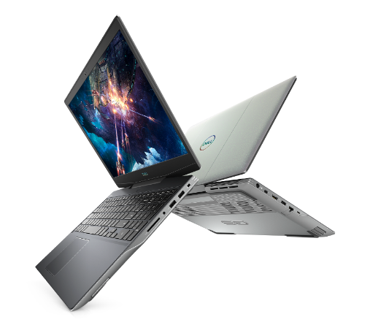
Key Claims: Dell G15 SE
Configuration | MobileMark 2014
Tbd | tbd
*The stated Watt Hour (WHr) is not an indication of battery life.
** Battery life is based on Mobile Mark 2014 benchmark test, available at www.bapco.com. Test results are for comparative purposes only. Actual battery life may be significantly less than the test results and varies depending on product configuration and use, software, usage, operating conditions, power management settings and other factors. Maximum battery life will decrease with time.

Slide 12
generational compare: Dell G15
Spec | Dell G5 15 (5500) | Dell G15 (5510) | Dell G15 SE (5505) | Dell G15 Ryzen Edition (5515)
Processor | 10th Gen Intel Core i5 Quad Core and i7 Hex Core | 10th Gen Intel Core i5 Quad Core and i7 Hex Core | AMD® Ryzen™ 5 4600H or Ryzen™ 7 4800H Mobile Processor | AMD Ryzen™ 5 5600H 6-core/12-thread Mobile Processor AMD Ryzen™ 7 5800H 8-core/16-thread Mobile Processor
Memory | 8 -16 GB DDR4 at 2933MHz, up to 32 GB (additional memory sold separately) | 8 -16 GB DDR4 at 2933MHz, up to 32 GB (additional memory sold separately) | 8 - 16GB, 3200 MHz, DDR4; up to 32GB (additional memory sold separately) | 8 - 16GB, 3200 MHz, DDR4; up to 32GB (additional memory sold separately)
Storage | Single storage options up to 1TB PCIe M.2 SSD Dual storage options up to 512GB PCIe M.2 SSD (Class 35) + 512GB PCIe M.2 SSD (Class 40) | Single storage options up to 1TB PCIe M.2 SSD Dual storage options up to 512GB PCIe M.2 SSD (Class 35) + 512GB PCIe M.2 SSD (Class 40) | Single storage options up to 1TB PCIe M.2 SSD Dual storage option 512GB PCIe M.2 SSD (Class 35) + 512GB PCIe M.2 SSD (Class 40) | Single storage options up to 1TB PCIe M.2 SSD Dual storage option 512GB PCIe M.2 SSD (Class 35) + 512GB PCIe M.2 SSD (Class 40)
Graphics | NVIDIA® GeForce® GTX 1650 Ti, 4GB GDDR6 NVIDIA® GeForce® GTX 1660 Ti or RTX 2060, 6GB GDDR6 NVIDIA® GeForce® RTX 2070 with Max-Q Design, 8GB GDDR6 | NVIDIA® GeForce® GTX 1650, 4GB GDDR6 NVIDIA® GeForce RTX™ 3050 NVIDIA® GeForce RTX™ 3050Ti NVIDIA® GeForce RTX™ 3060, 8GB GDDR6 | AMD Radeon™ RX 5600M | NVIDIA® GeForce® RTX™ 3050 NVIDIA® GeForce® RTX™ 3050 Ti NVIDIA® GeForce RTX™ 3060, 8GB GDDR6
Display | 15.6” FHD (1920 x 1080) 220 nits Anti-Glare LED Backlit Display 60Hz 15.6” FHD (1920 x 1080) 300 nits Anti-Glare LED Backlit Display 144Hz 15.6” FHD (1920 x 1080) 300 nits WVA Anti-Glare LED Backlit Display 300Hz | 15.6” FHD (1920 x 1080) 250 nits Anti-Glare LED Backlit Display 120Hz 15.6” FHD (1920 x 1080) 300 nits Anti-Glare LED Backlit Display 165Hz | 15.6” FHD (1920 x 1080) 220 nits Anti-Glare LED Backlit Display 60Hz 15.6” FHD (1920 x 1080) 300 nits Anti-Glare LED Backlit Display 144Hz | 15.6” FHD (1920 x 1080) 250 nits Anti-Glare LED Backlit Display 120Hz 15.6” FHD (1920 x 1080) 300 nits Anti-Glare LED Backlit Display 165Hz
Battery | 56 WHr, 4-Cell Battery (Integrated) | 56 WHr, 4-Cell Battery (Integrated) / 86 WHr, 4-Cell Battery (Integrated) on RTX 3060 | 51 WHr, 3-Cell Battery (integrated) 68 WHr, 4-Cell Battery (integrated) | 56 WHr, 4-Cell Battery (Integrated) / 86 WHr, 4-Cell Battery (Integrated) on RTX 3060
Keyboard / touchpad | Backlit full-size, spill-resistant WASD keyboard with numeric keypad with Game Shift key at F7 (US English only) Optional 4-zone RGB backlit full-size, spill-resistant WASD keyboard with numeric keypad with Game Shift key at F7 (US English only) | Orange backlit full-size, spill-resistant WASD keyboard with numeric keypad with Game Shift key at F9 (US English only) Optional 4-zone RGB backlit full-size, spill-resistant WASD keyboard with numeric keypad with Game Shift key at F9 (US English only) | Backlit full-size, spill-resistant WASD keyboard with numeric keypad with Game Shift key at F7 (US English only) Optional 4-zone RGB backlit full-size, spill-resistant WASD keyboard with numeric keypad with Game Shift key at F7 (US English only) | Orange backlit full-size, spill-resistant WASD keyboard with numeric keypad with Game Shift key at F9 (US English only) Optional 4-zone RGB backlit full-size, spill-resistant WASD keyboard with numeric keypad with Game Shift key at F9 (US English only)
Optical drive | n/a | n/a | n/a | n/a
Camera/ FPR | Integrated Widescreen HD (720p) Webcam with Dual Array Digital Microphone | Integrated Widescreen HD (720p) Webcam with Dual Array Digital Microphone | Integrated widescreen HD (720p) Webcam with Dual Array Digital Microphone | Integrated widescreen HD (720p) Webcam with Dual Array Digital Microphone
Ports | (1) HDMI 2.0, (1) SuperSpeed USB 3.2 Gen 1, (2) SuperSpeed USB 2.0, (1) Standard SD Card slot, wedge lock slot, Headphone/Mic Only on GTX 1650Ti: (1) USB-C DisplayPort Alt-Mode only; (1) RJ45 Only on GTX 1660Ti and above: (1) Thunderbolt™ 3 Port (USB 3.1 Gen 2 Type-C™ with support for 40 Gbps Thunderbolt and DisplayPort); (1) miniDP; (1) RJ-45 Killer Networks E2500V2 Gigabit Ethernet Port | (1) HDMI 2.0, (1) SuperSpeed USB 3.2 Gen 1, (1) SuperSpeed USB 2.0 with PowerShare, (1) SuperSpeed USB 2.0, (1) RJ45, Headphone/Mic Only on GN20-P: (1) USB-C DisplayPort Alt-Mode only; Only on RTX 3060: (2) SuperSpeed USB 3.2 Gen 1, (1) SuperSpeed USB 2.0 with PowerShare, (1) Thunderbolt™ 3 Port (USB 3.1 Gen 2 Type-C™ with support for 40 Gbps Thunderbolt and DisplayPort); (1) RJ-45 Killer Networks E2500V2 Gigabit Ethernet Port | (1) HDMI 2.0, (1) SuperSpeed USB 3.2 Gen 1, (2) SuperSpeed USB 2.0, (1) miniDP, (1) USB-C DisplayPort Alt-Mode only, (1) RJ45, (1) Standard SD Card slot, wedge lock slot, Headphone/Mic | (1) HDMI 2.0, (1) SuperSpeed USB 3.2 Gen 1, (1) SuperSpeed USB 2.0 with PowerShare, (1) SuperSpeed USB 2.0, (1) RJ45, (1) USB-C DisplayPort Alt-Mode only; Headphone/Mic Only on RTX 3060: (2) SuperSpeed USB 3.2 Gen 1, (1) SuperSpeed USB 2.0 with PowerShare, (1) Thunderbolt™ 3 Port (USB 3.1 Gen 2 Type-C™ with support for 40 Gbps Thunderbolt and DisplayPort); (1) RJ-45 Killer Networks E2500V2 Gigabit Ethernet Port
Construction | Plastic, optional 12-zone chassis lighting | Plastic | Plastic | Plastic
Dimensions (H x W x D) | 21.6 x 365.5 x 254mm / 0.85 x 14.4 x 10 inches | 21.2 x 357.3 x 272.8mm / 0.83 x 14.1 x 10.7 inches | 21.6 x 365.5 x 254mm / 0.85 x 14.4 x 10 inches | 21.2 x 357.3 x 272.8mm / 0.83 x 14.1 x 10.7 inches
Starting at weight* | 5.82 lb (2.64kg) with i5, NVIDIA GTX 1050, 256GB SSD, FHD non-touch | 5.39 lb (2.4449kg) | 5.51 lb (2.5kg) with AMD Ryzen 5 4600H Processor, AMD Radeon RX 5600M, 6GB DDR6, 8GB DDR4, 128 GB SSD, 3 cell 51 WHr battery | TBD
Notes:
Selek vs Sif

Slide 13
generational compare: Dell G15 10th Gen vs 11th Gen
Spec | Dell G15 10th Gen (5510) | Dell G15 11th Gen (5511) | Dell G15 Special Edition (5511)
Processor | 10th Gen Intel Core i5 Quad Core and i7 Hex Core | 11th Gen Intel Core i5 6-Cores and i7 8-Cores | 11th Gen Intel Core i5 6-Cores and i7 8-Cores
Memory | 8 -16 GB DDR4 at 2933MHz, up to 32 GB (additional memory sold separately) | 8 -16 GB DDR4 at 2933MHz, up to 32 GB (additional memory sold separately) | 8 -16 GB DDR4 at 2933MHz, up to 32 GB (additional memory sold separately)
Storage | Single storage options up to 1TB PCIe M.2 SSD Dual storage options up to 512GB PCIe M.2 SSD (Class 35) + 512GB PCIe M.2 SSD (Class 40) | Single storage options up to 1TB PCIe M.2 SSD Dual storage options up to 512GB PCIe M.2 SSD (Class 35) + 512GB PCIe M.2 SSD (Class 40) | Single storage options up to 1TB PCIe M.2 SSD Dual storage options up to 512GB PCIe M.2 SSD (Class 35) + 512GB PCIe M.2 SSD (Class 40)
Graphics | NVIDIA® GeForce® GTX 1650, 4GB GDDR6 NVIDIA® GeForce RTX™ 3050 NVIDIA® GeForce RTX™ 3050Ti NVIDIA® GeForce RTX™ 3060, 8GB GDDR6 | NVIDIA® GeForce RTX™ 3050 NVIDIA® GeForce RTX™ 3050Ti NVIDIA® GeForce RTX™ 3060, 8GB GDDR6 | NVIDIA® GeForce RTX™ 3050 NVIDIA® GeForce RTX™ 3050Ti NVIDIA® GeForce RTX™ 3060, 8GB GDDR6
Display | 15.6” FHD (1920 x 1080) 250 nits Anti-Glare LED Backlit Display 120Hz 15.6” FHD (1920 x 1080) 300 nits Anti-Glare LED Backlit Display 165Hz | 15.6” FHD (1920 x 1080) 250 nits Anti-Glare LED Backlit Display 120Hz 15.6” FHD (1920 x 1080) 300 nits Anti-Glare LED Backlit Display 165Hz | 15.6” FHD (1920 x 1080) 300 nits Anti-Glare LED Backlit Display 165Hz 15.6” FHD (1920 x 1080) 300 nits Anti-Glare LED Backlit Display 360Hz
Battery | 56 WHr, 4-Cell Battery (Integrated) / 86 WHr, 4-Cell Battery (Integrated) on RTX 3060 | 56 WHr, 4-Cell Battery (Integrated) / 86 WHr, 4-Cell Battery (Integrated) on RTX 3060 | 56 WHr, 4-Cell Battery (Integrated) / 86 WHr, 4-Cell Battery (Integrated) on RTX 3060
Keyboard / touchpad | Orange backlit full-size, spill-resistant WASD keyboard with numeric keypad with Game Shift key at F9 (US English only) Optional 4-zone RGB backlit full-size, spill-resistant WASD keyboard with numeric keypad with Game Shift key at F9 (US English only) | Orange backlit full-size, spill-resistant WASD keyboard with numeric keypad with Game Shift key at F9 (US English only) Optional 4-zone RGB backlit full-size, spill-resistant WASD keyboard with numeric keypad with Game Shift key at F9 (US English only) | Orange backlit full-size, spill-resistant WASD keyboard with numeric keypad with Game Shift key at F9 (US English only) Optional 4-zone RGB backlit full-size, spill-resistant WASD keyboard with numeric keypad with Game Shift key at F9 (US English only)
Optical drive | n/a | n/a | n/a
Camera/ FPR | Integrated Widescreen HD (720p) Webcam with Dual Array Digital Microphone | Integrated Widescreen HD (720p) Webcam with Dual Array Digital Microphone | Integrated Widescreen HD (720p) Webcam with Dual Array Digital Microphone
Ports | (1) HDMI 2.0, (1) SuperSpeed USB 3.2 Gen 1, (1) SuperSpeed USB 2.0 with PowerShare, (1) SuperSpeed USB 2.0, (1) RJ45, Headphone/Mic Only on GN20-P: (1) USB-C DisplayPort Alt-Mode only; Only on RTX 3060: (2) SuperSpeed USB 3.2 Gen 1, (1) SuperSpeed USB 2.0 with PowerShare, (1) Thunderbolt™ 3 Port (USB 3.1 Gen 2 Type-C™ with support for 40 Gbps Thunderbolt and DisplayPort); (1) RJ-45 Killer Networks E2500V2 Gigabit Ethernet Port | (1) HDMI 2.0, (1) SuperSpeed USB 3.2 Gen 1, (1) SuperSpeed USB 2.0 with PowerShare, (1) SuperSpeed USB 2.0, (1) RJ45, Headphone/Mic Only on GN20-P: (1) USB-C DisplayPort Alt-Mode only; Only on RTX 3060: (2) SuperSpeed USB 3.2 Gen 1, (1) SuperSpeed USB 2.0 with PowerShare, (1) Thunderbolt™ 3 Port (USB 3.1 Gen 2 Type-C™ with support for 40 Gbps Thunderbolt and DisplayPort); (1) RJ-45 Killer Networks E2500V2 Gigabit Ethernet Port | (1) HDMI 2.0, (1) SuperSpeed USB 3.2 Gen 1, (1) SuperSpeed USB 2.0 with PowerShare, (1) SuperSpeed USB 2.0, (1) RJ45, Headphone/Mic Only on GN20-P: (1) USB-C DisplayPort Alt-Mode only; Only on RTX 3060: (2) SuperSpeed USB 3.2 Gen 1, (1) SuperSpeed USB 2.0 with PowerShare, (1) Thunderbolt™ 3 Port (USB 3.1 Gen 2 Type-C™ with support for 40 Gbps Thunderbolt and DisplayPort); (1) RJ-45 Killer Networks E2500V2 Gigabit Ethernet Port
Construction | Plastic | Plastic | Plastic
Dimensions (H x W x D) | 21.2 x 357.3 x 272.8mm / 0.83 x 14.1 x 10.7 inches | 21.2 x 357.3 x 272.8mm / 0.83 x 14.1 x 10.7 inches | 21.2 x 357.3 x 272.8mm / 0.83 x 14.1 x 10.7 inches
Starting at weight* | 5.39 lb (2.4449kg) | TBD | TBD
Notes:
Sif CML + Sif TGL/Sif SE

